Slide 1

Onondaga County DSS-ES
CAREER DETAILS
Welcome
FUTURE
TEAM MEMBER
*This document does not confer any benefits. Benefits are subject to change. To ensure you have the most accurate information, please contact the County’s Personnel Department (see last slide).
LAST REV. AUGUST 2026

Slide 2
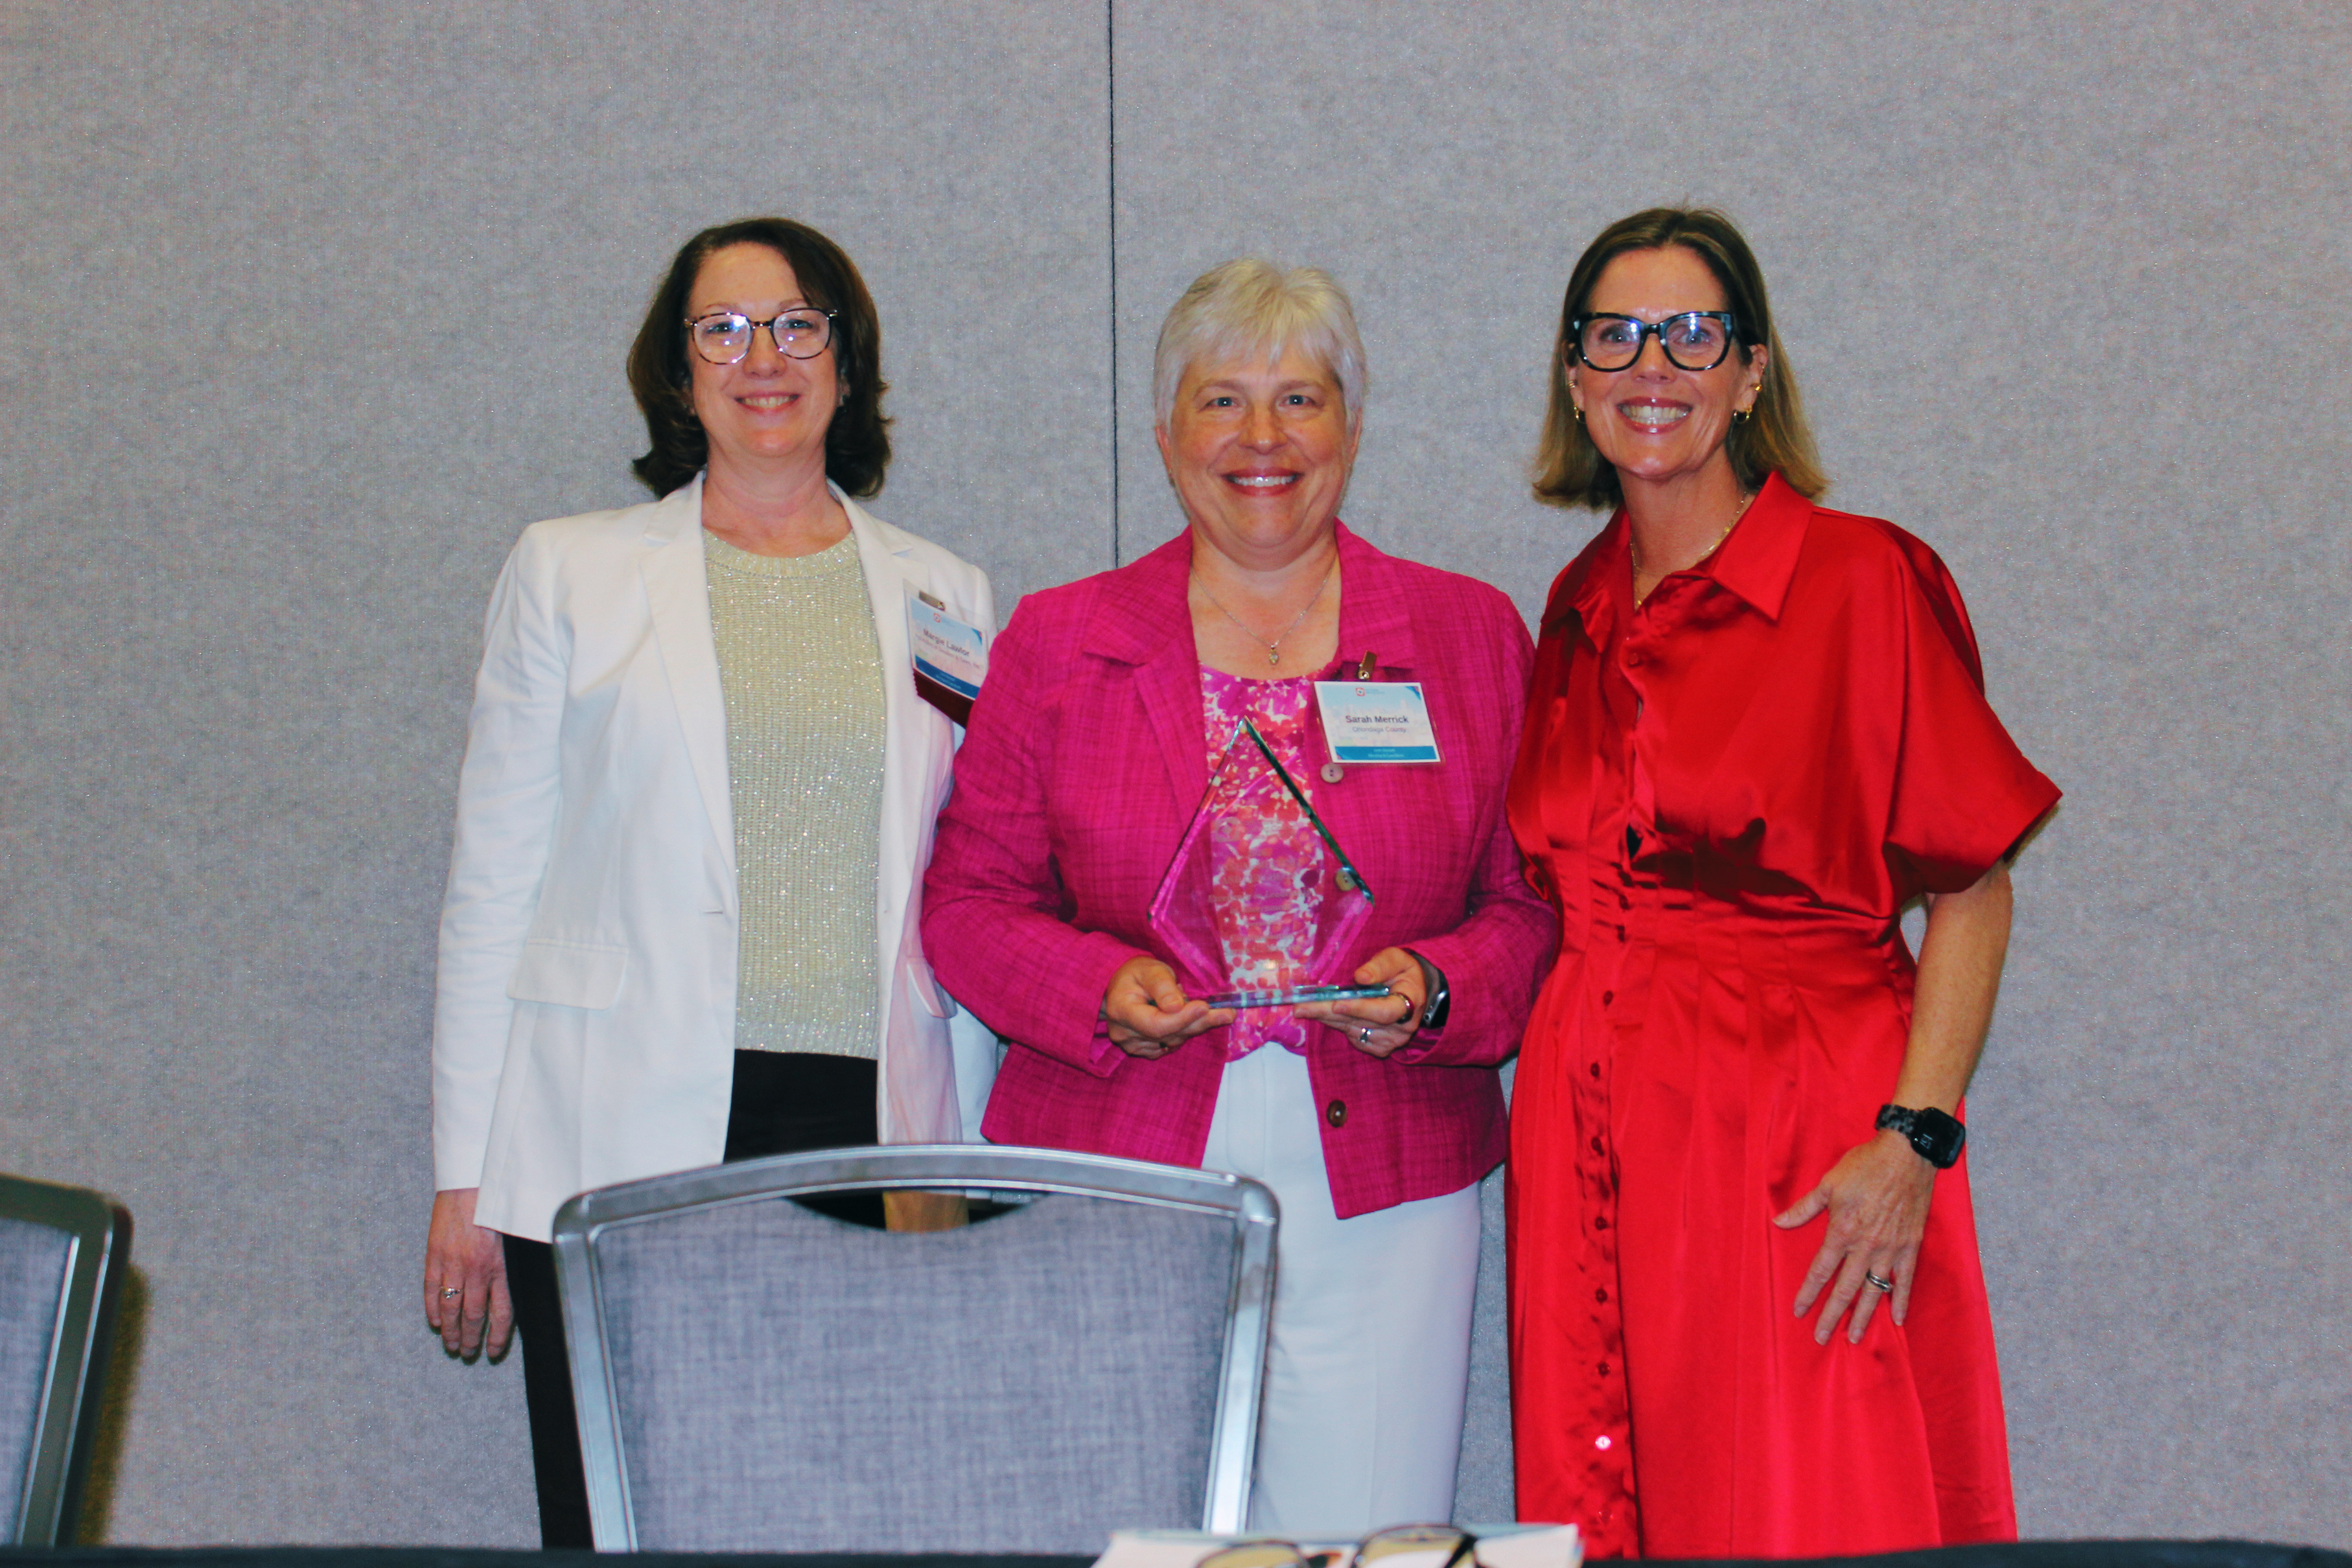

Onondaga County DSS-ES
CAREER DETAILS
HELLO!
My name is Sarah Merrick and I’d like to welcome you to the Department of Social Services - Economic Security. We're excited you are considering joining our team!
Your energy and skills are exactly what we need, and we can't wait to see the awesome things you’ll contribute.
Sarah G. Merrick
DSS-ES Commissioner

Slide 3
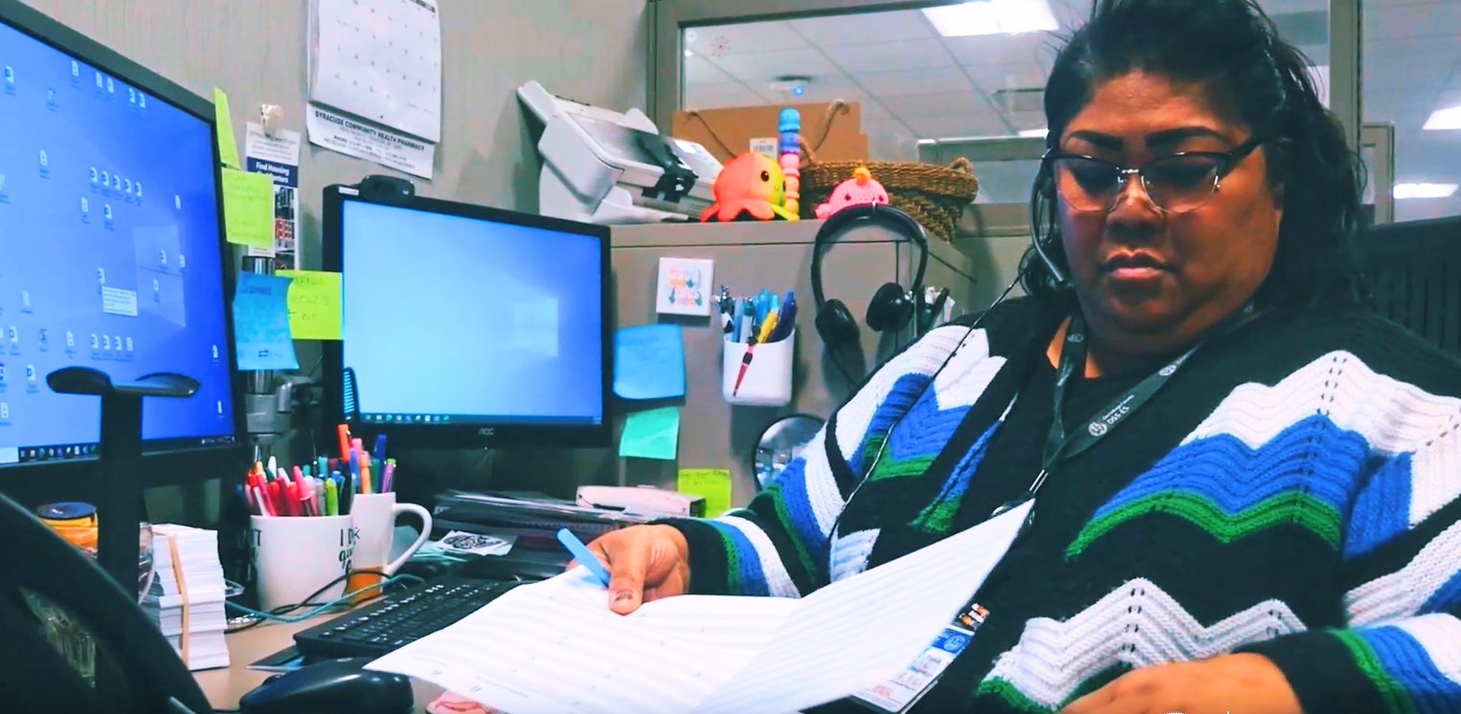
Onondaga County DSS-ES
CAREER DETAILS
HEAR FROM OUR TEAM
What’s it really like to work at DSS-ES? Hear directly from the people who know it best — our employees.
Our team shares what they enjoy about their work, what makes DSS-ES a great place to grow, and why being part of our department is meaningful to them.
WATCH THEIR STORY

Slide 4
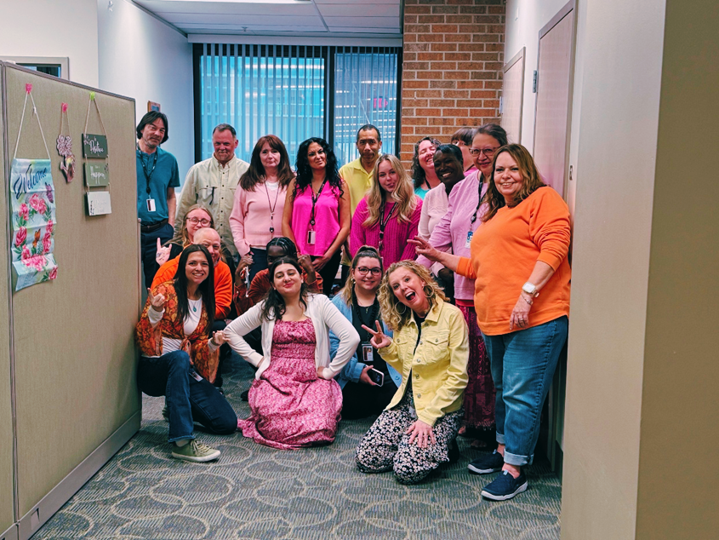
Onondaga County DSS-ES
CAREER DETAILS
About Our Department
AGENDA OVERVIEW
Learn who we are, who we serve, and how our work impacts the community.
Our Vision & Mission
Get to know DSS-ES as a workplace, the purpose behind what we do, and the opportunities available to you. We’ll walk through what you can expect as an employee and how we support you throughout your career.
Discover the shared purpose and values that guide the work we do every day.
Training & Development
See how we help employees build their skills, grow, and succeed.
Benefits & Perks
Learn about the benefits, flexibility, and resources that come with being part of our team.
Available Jobs
Explore current opportunities and find a role that matches your skills and interests.

Slide 5
Onondaga County DSS-ES
CAREER DETAILS
ABOUT DSS-ES
Department of Social Services - Economic Security
Serving Our Community
Our Impact: 1 in 4 County Residents
Every day, DSS-ES helps individuals and families across Onondaga County get the support they need. Our work directly impacts 1 in 4 residents in our community.
More Than A Workplace
Our Mission: Helping People Thrive
We’re connected by a shared purpose: giving back to our community. Your talents become part of that mission, helping ensure people receive the support they need to move forward and thrive.

Slide 6
Onondaga County DSS-ES
CAREER DETAILS
OUR PURPOSE
Our Mission
Our Vision
To accurately and efficiently administer economic support and services to county residents in a respectful manner where each person is treated fairly.
To help create a community where people and families achieve their highest level of independence.

Slide 7
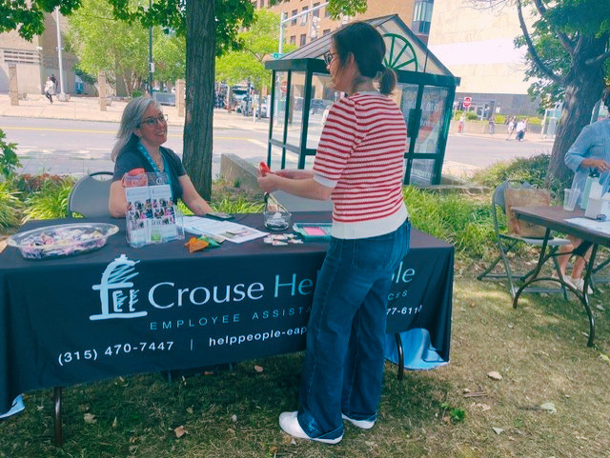
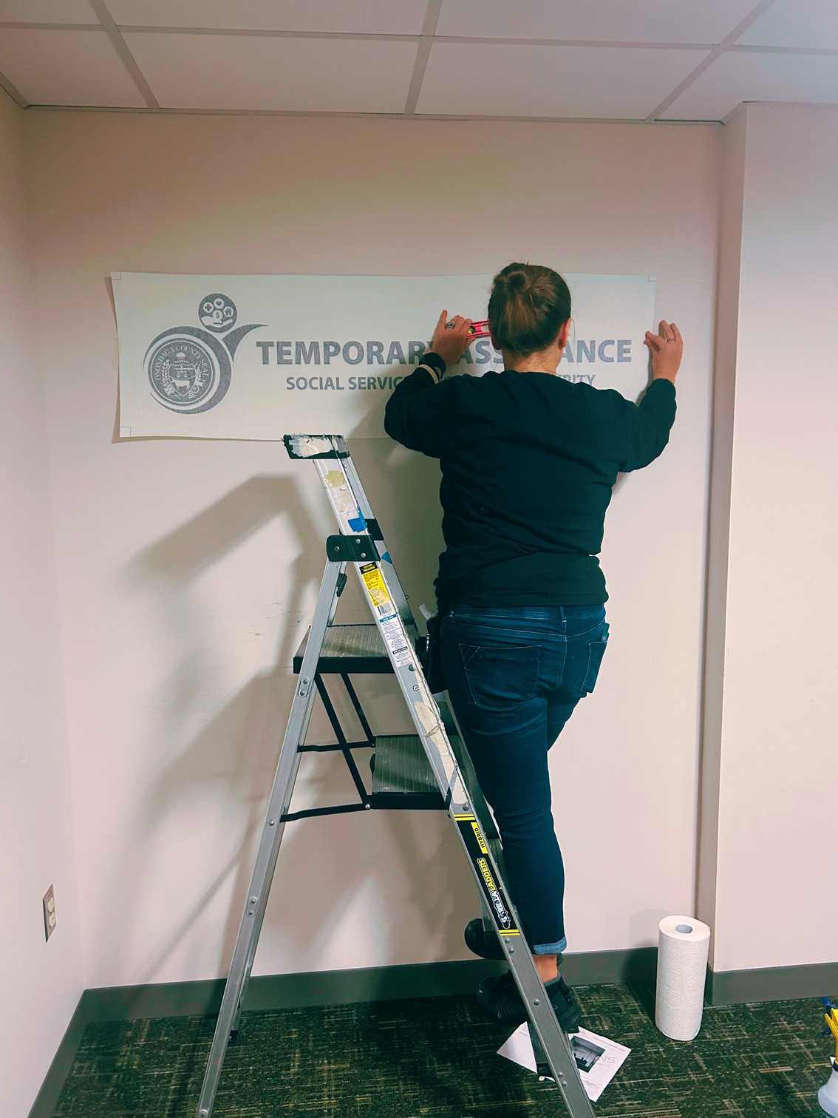
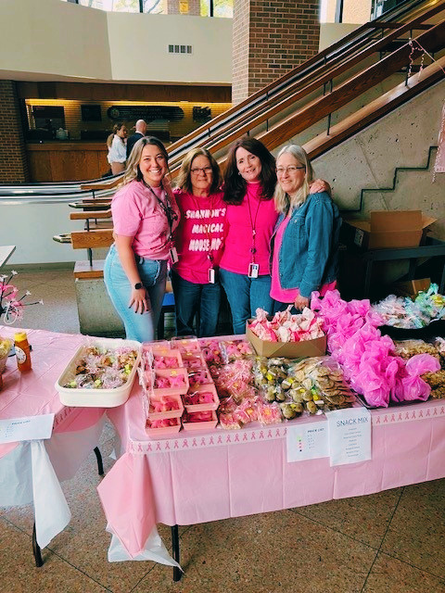
Onondaga County DSS-ES
CAREER DETAILS
WORKSPACE & FACILITIES
01
02
03
Wellness & Relaxation
Comfort That Works for You
More Than Just Work
Take time to recharge with wellness programs, relaxation spaces, and dedicated lactation lounges designed to support your well-being.
Connect with coworkers through social events and activities that bring our team together and make DSS-ES a welcoming place to work.
Enjoy ergonomic workstations and support from our facilities team, who can help adjust your workspace to better fit your comfort and needs.

Slide 8
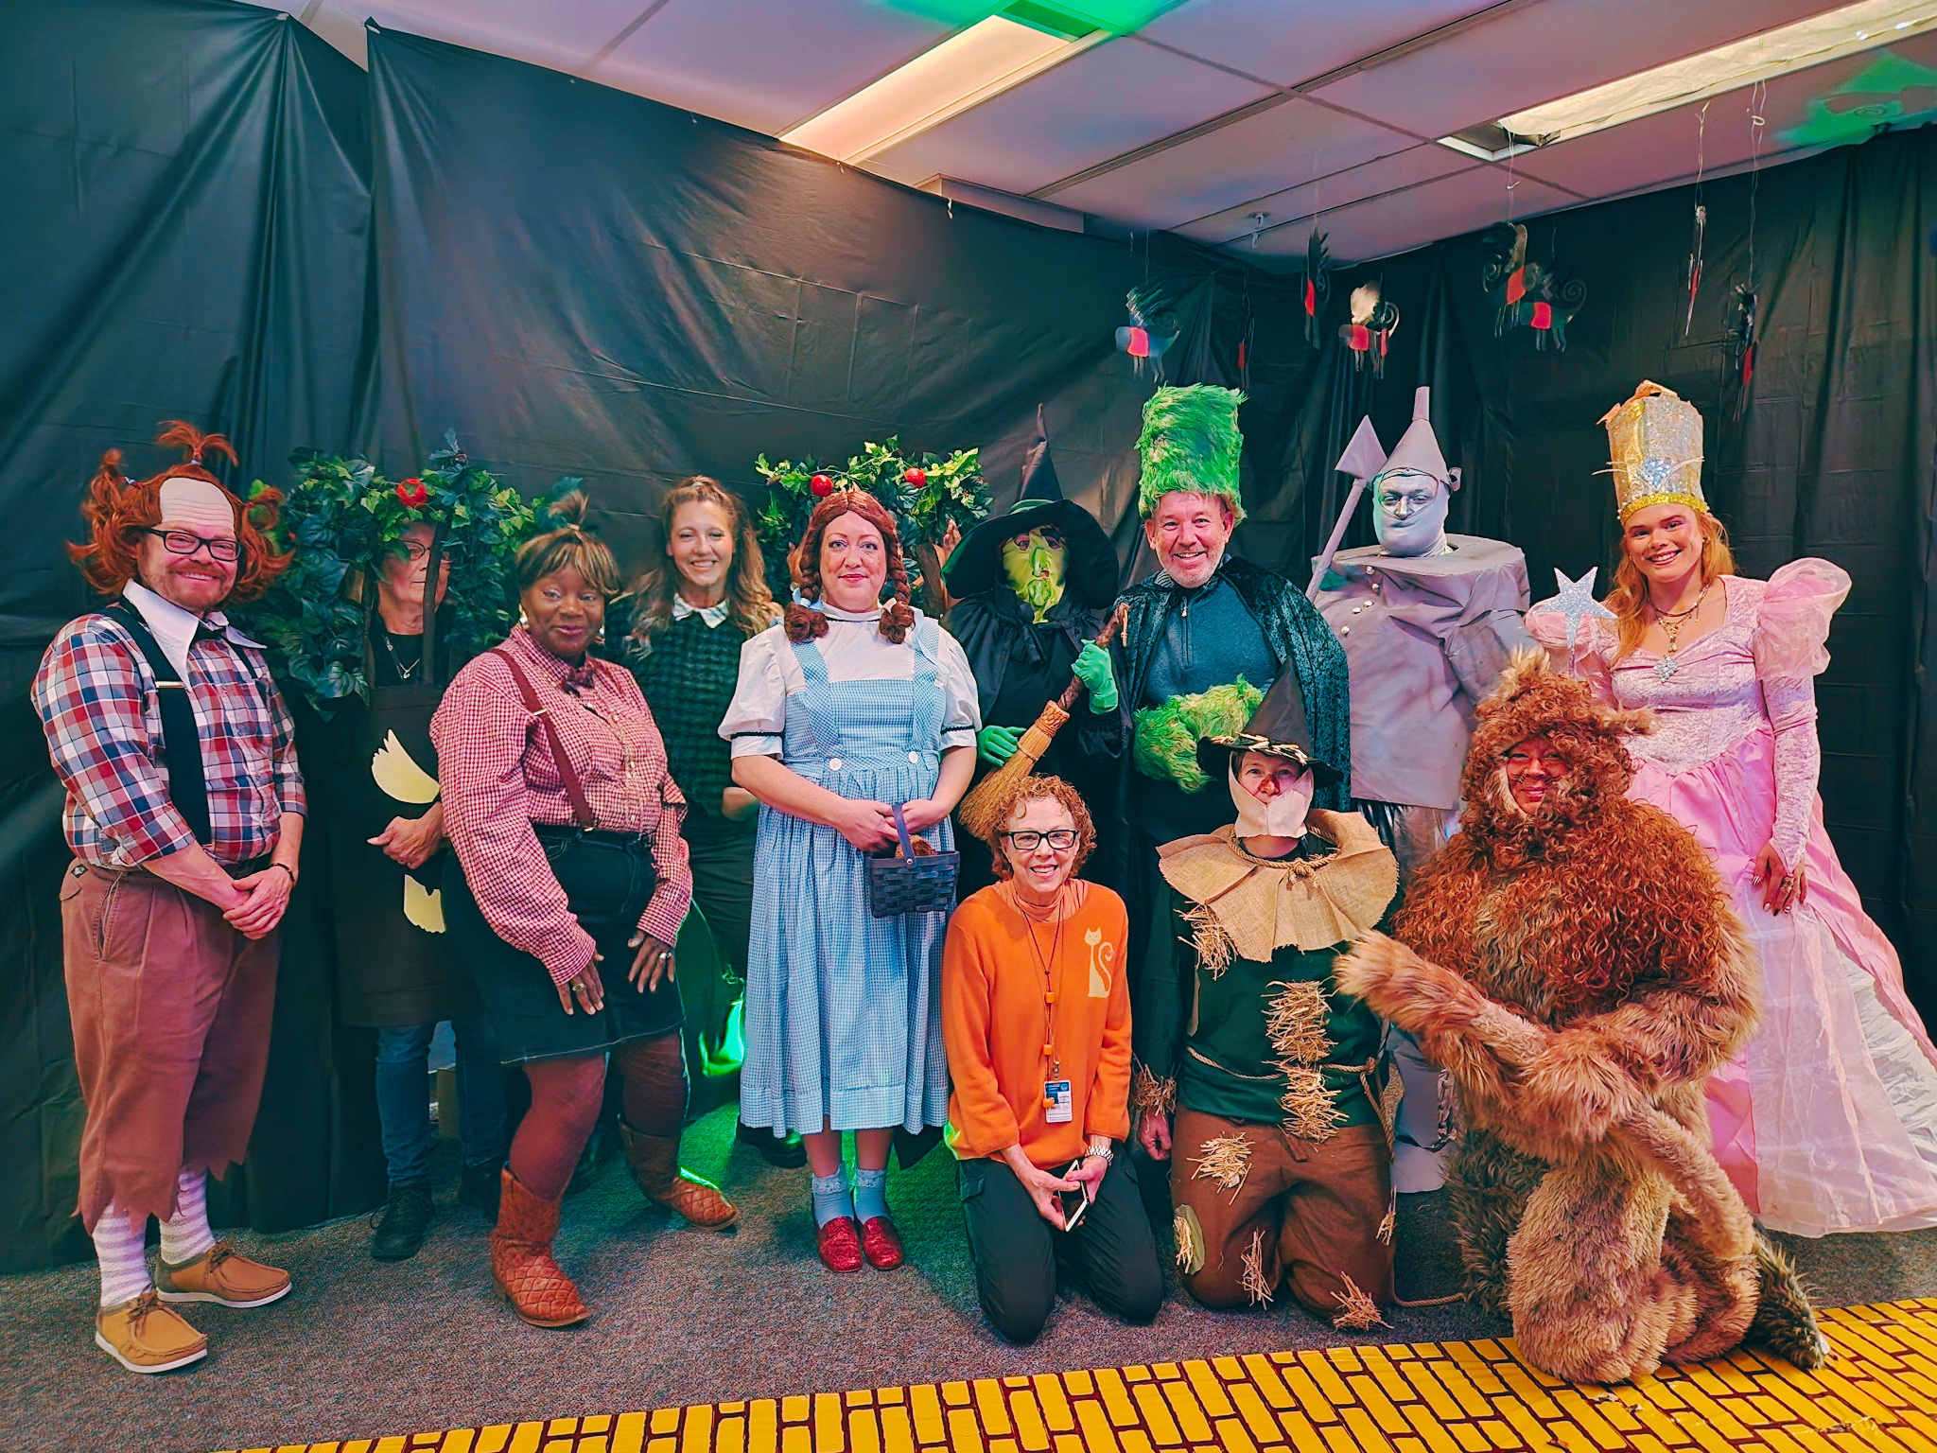
Onondaga County DSS-ES
CAREER DETAILS
DEPARTMENT CULTURE
Collaboration and Inclusivity
Continuous Learning and Growth
Open Communication and Transparency
We believe that diverse perspectives foster innovation, and every voice is valued. Expect a workplace where your ideas are not only heard but actively encouraged.
We embrace a culture of continuous learning. Your professional growth is a priority, and we provide resources, mentorship, and opportunities for skill development.
Communication is at the heart of our culture. We believe in transparency and open dialogue at all levels.

Slide 9
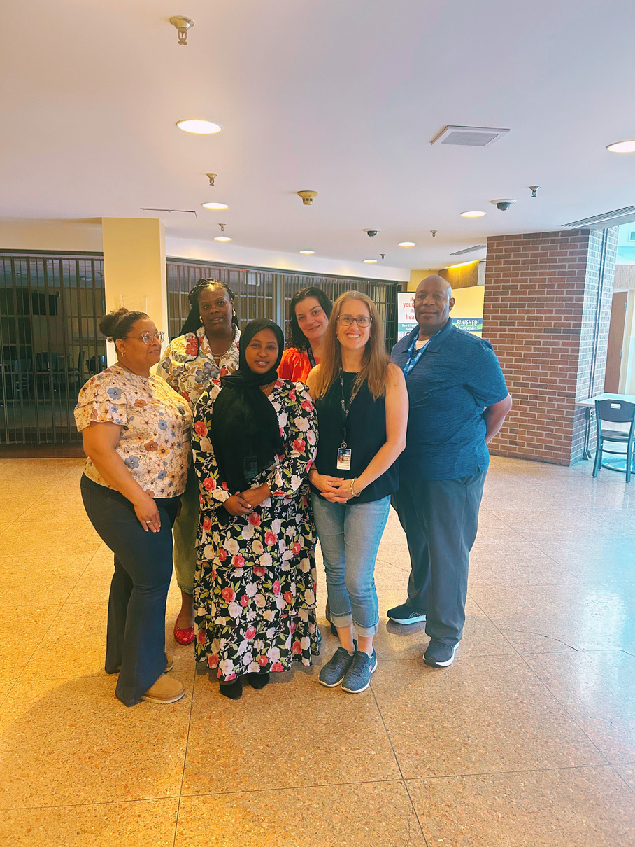
Onondaga County DSS-ES
CAREER DETAILS
TRAINING & DEVELOPMENT
Comprehensive Onboarding
Start with the skills, knowledge, and support you need to feel confident in your role and make a meaningful impact in our community.
Continuous Learning & Growth
Keep growing through ongoing training, workshops, mentorship, and professional development opportunities designed to support your career.

Slide 10
Onondaga County DSS-ES
CAREER DETAILS
BENEFITS & PERKS
Benefits designed to support your life — at work and beyond.
01
Affordable Coverage
Health coverage starts the first of the month following your hire date. Approximate monthly costs range from $103–$115 individual and $278–$309 family coverage.
02
Paid Time Off
From affordable coverage and paid time off to flexible schedules and retirement benefits, County employment offers more than a paycheck. Our benefits are designed to support your health, your future, and a healthy balance between your career and life outside of work.
Make time for life outside of work with vacation, personal and sick time, plus federal and floating holidays throughout the year.
03
Work-Life Balance
Enjoy a 35-hour workweek with flexible scheduling opportunities. After probation, eligible employees may have access to a 4-day workweek or hybrid work options.
Benefits, eligibility, and employee costs may vary based on pay grade, bargaining unit, labor agreements, and other factors. Rates shown are approximate. Contact the County Personnel Department for current information.

Slide 11
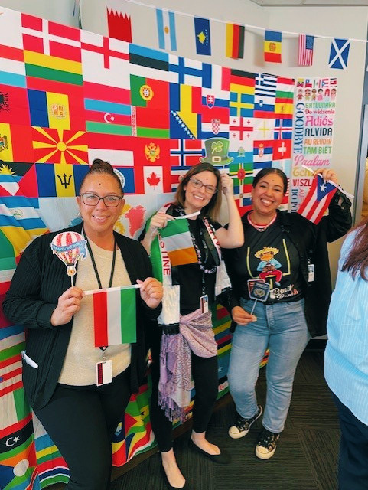
Onondaga County DSS-ES
CAREER DETAILS
...PLUS MORE!
Health & Savings Benefits
Take advantage of affordable dental and prescription coverage, along with tax-advantaged options such as Flexible Spending Accounts and 457(b) plans to help you plan and save.
Invest in Your Future
Build a career today while preparing for tomorrow.
Eligible employees can participate in the New York State pension system, with vesting after five years of service, and access discounted learning opportunities through Syracuse University’s College of Professional Studies.
Benefits, eligibility, and employee costs may vary based on pay grade, bargaining unit, labor agreements, and other factors. Rates shown are approximate. Contact the County Personnel Department for current information.

Slide 12

Onondaga County DSS-ES
CAREER DETAILS
FREQUENTLY AVAILABLE POSITIONS
$40,995
$37,669
$49,805
Account Clerk I
Clerk I
IM Worker
This work involves performing specialized cllerical work for our Public Assistance Programs.
This job requires no prior work experience, and involves basic clerical work for our Public Assistance Programs.
This position is responcible for determining financial and categorical eligibility for our Public Assistance Programs.

Slide 13
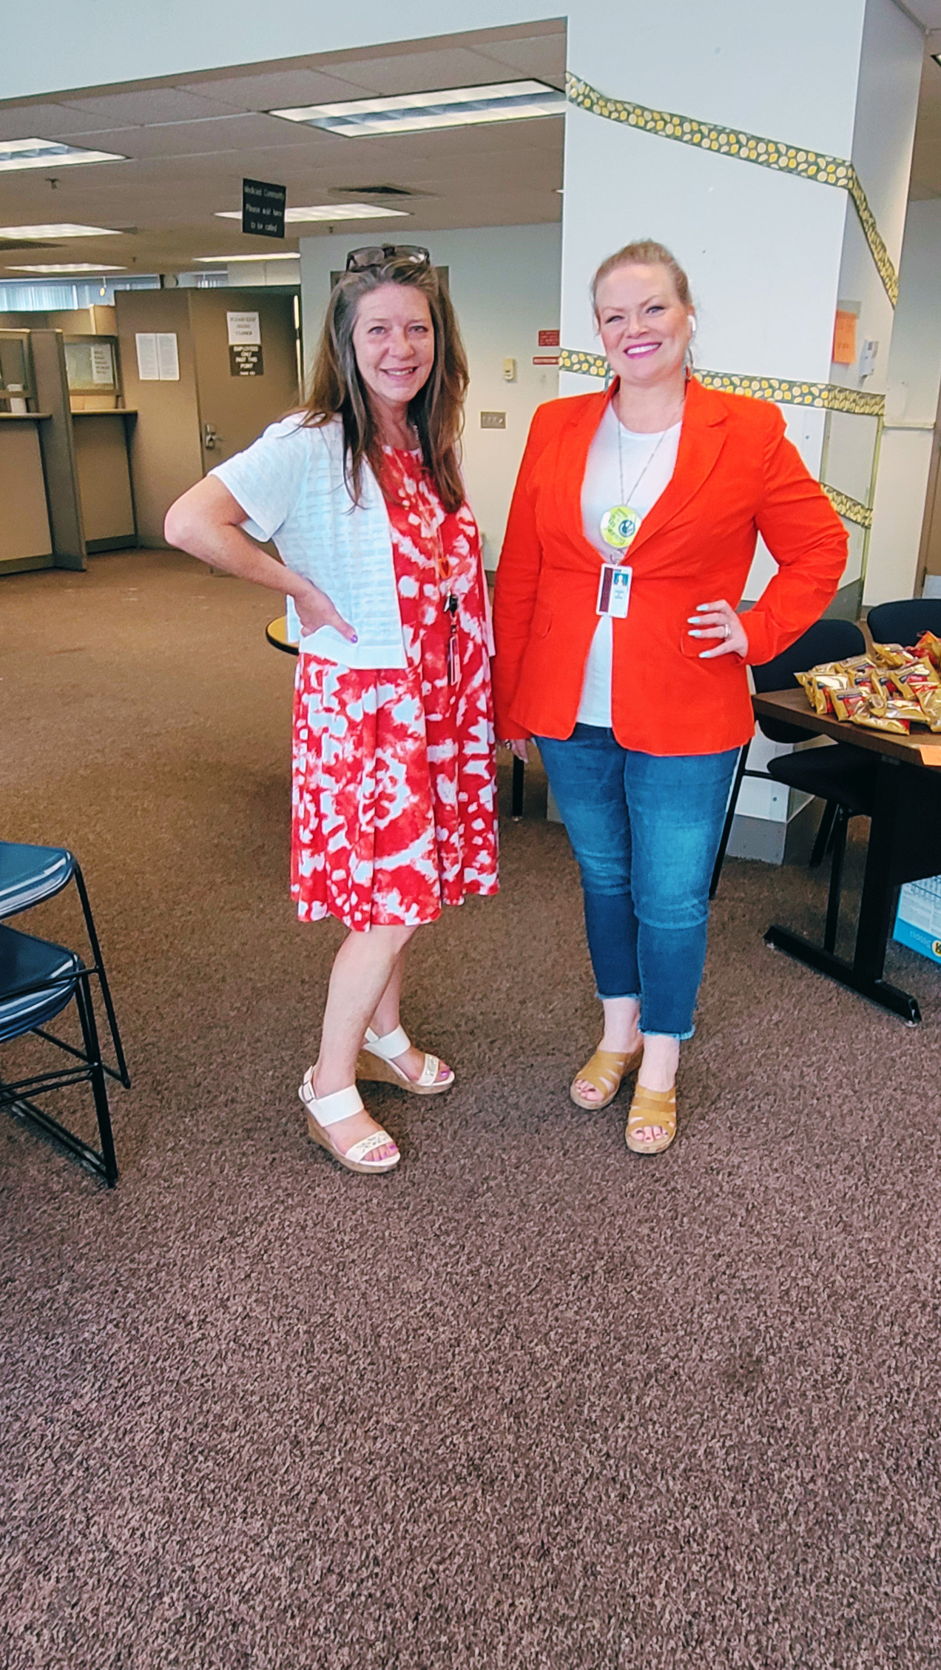
Onondaga County DSS-ES
CAREER DETAILS
QUESTIONS?
Considering a new job is a significant decision. We’d love the opportunity to address any remaining questions you may have. This is your chance to seek clarification on any aspect of your role or our department. Your questions are valuable, and we're here to ensure you feel confident and well-informed.
Contact DSS Personnel
You can email any questions to Liz O’Hara at
Elizabeth.Ohara@dfa.state.ny.us
Contact County Personnel
You can contact County Personnel at
www.ongov.net/benefits/contact.html or by calling 315-435-3498.

Slide 14
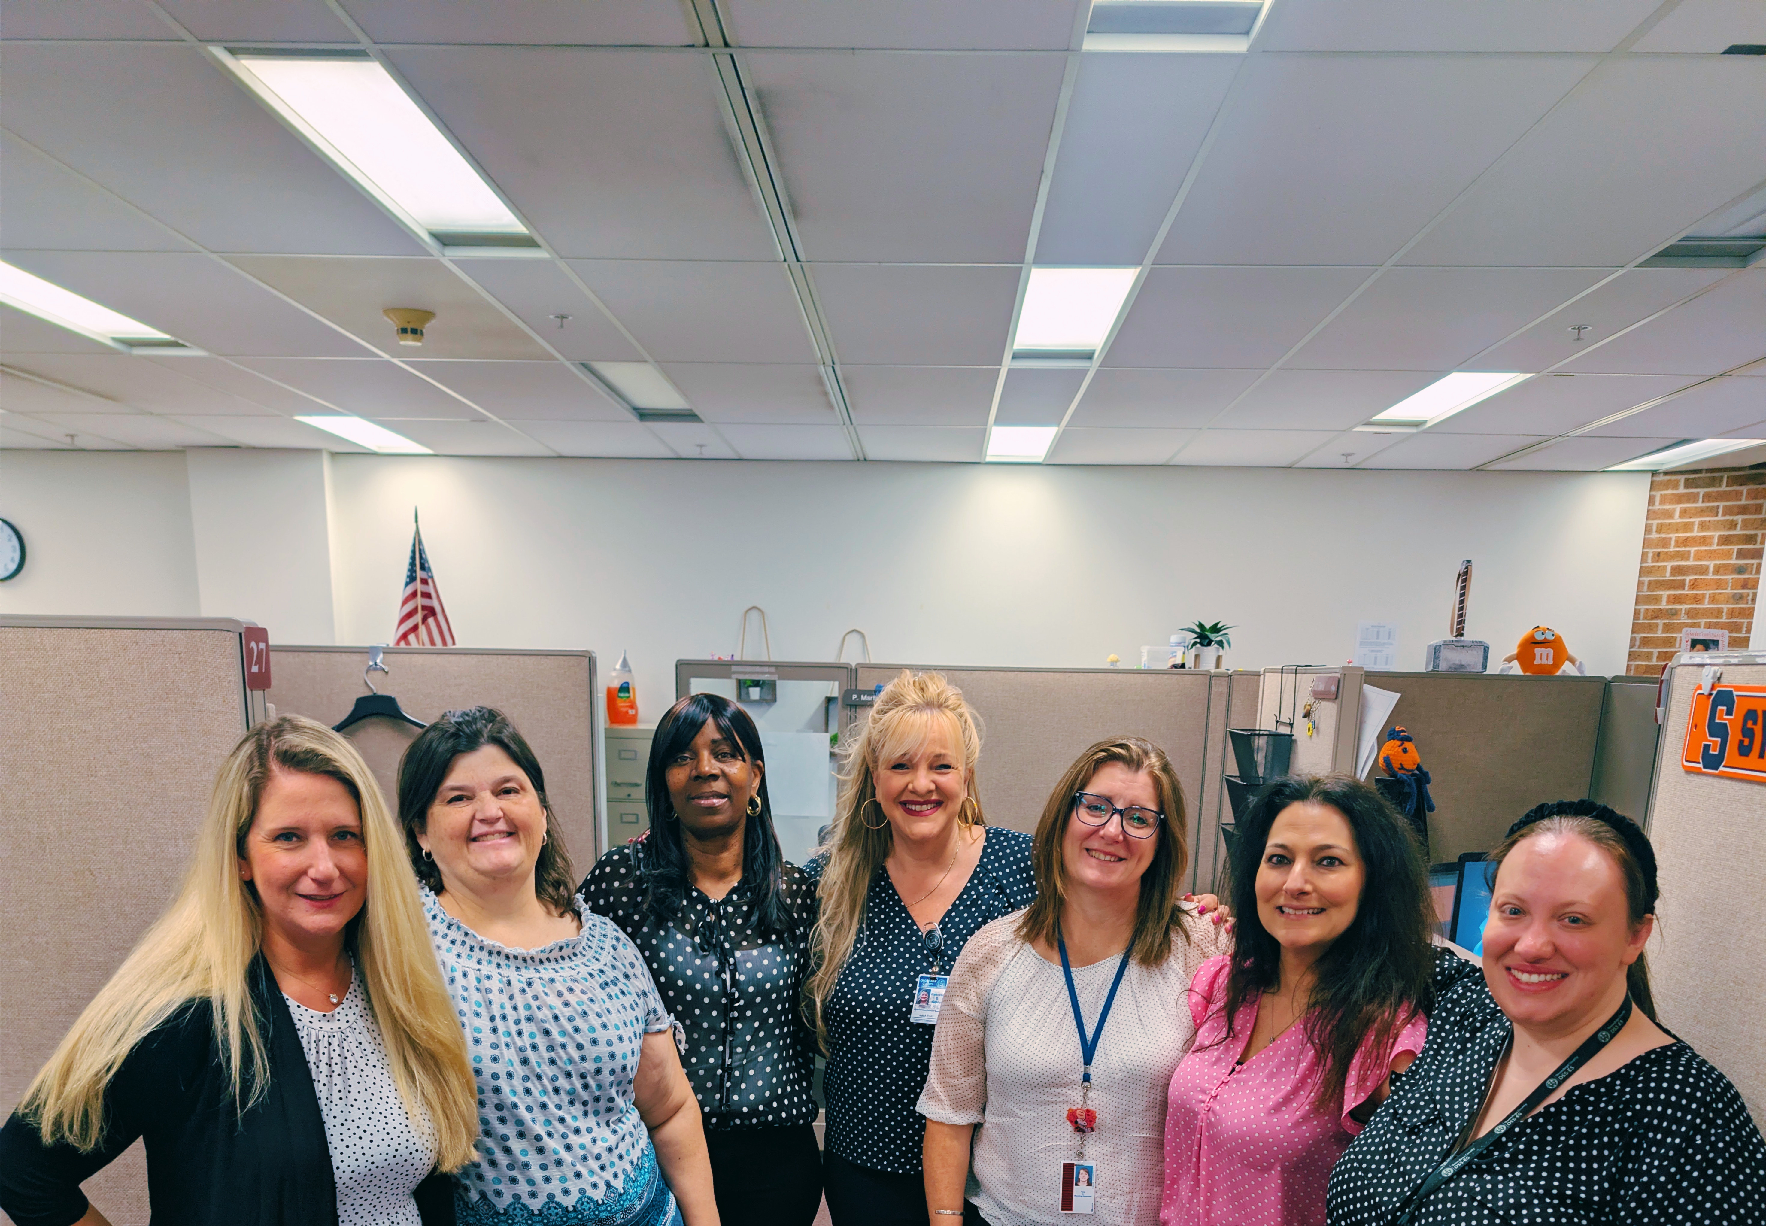
Thank You
FOR CONSIDERING OUR TEAM
Ready to make an impact? Your next opportunity could start right here.
Build a career that gives back to your community and gives you room to grow.
At DSS-ES, your work matters. Join a team where your talents can make a difference for individuals and families across our community while building a career you can be proud of.
Notes:
Left-side statement:
Ready to make an impact? Your next opportunity could start right here.
Large highlighted statement:
Build a career that gives back to your community — and gives you room to grow.
Smaller supporting text:
At DSS-ES, your work matters. Join a team where your talents can make a difference for individuals and families across our community while building a career you can be proud of.

